Slide 1
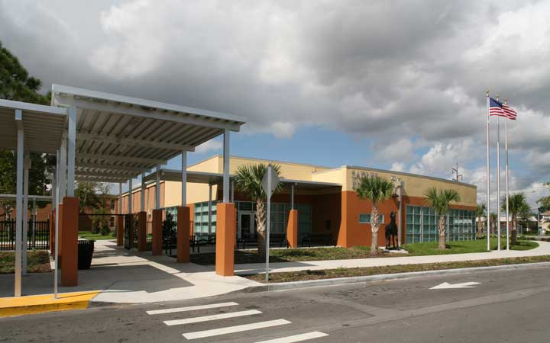
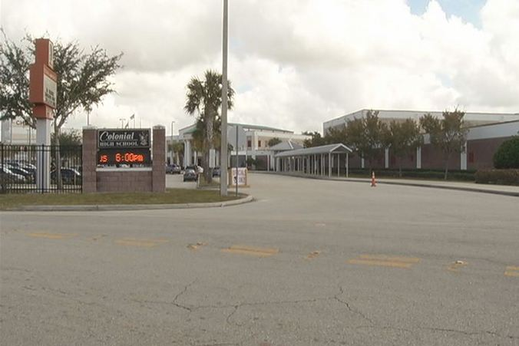
Field Observation
Intro to Diversity for Educators
EDF 2085
Dr. Qadri
Julio Quispe

Slide 2
Cultural/Faith Diversity
A good artifact that I can take into account is the project Mr. Grace had his students do: They had to draw their face on a paper, in the front they had to write down five things other students would know of them, and on the back five things students did not know. I believe this was a great way learn objective and subjective culture. I have read some of the papers that were turned in (the assignment was already performed the week before I was observing) and some did mention their beliefs. Some posted it in the five things people did not know, for instance: I remember one student posted that probably others will not know “I am Catholic.”
Mr. Grace was telling me about a prior lesson which was about knowing how to deal and knowing the some background about the groups of people coming to the hotel (this was a hospitality class.) He said that it is important to know what people are at the hotel. Some groups might not get mix or get along well with others. I would take this example as a reason to teach a lesson of the importance of knowing different cultural backgrounds! It is important to know several backgrounds to communicate effectively and that way, possibly avoid offending others due to ignorance.
When I was at Sadler Elementary, Mrs. Velez was showing me around the campus, and I have noticed that there were many student work about Spain posted in the hallway. I asked her why is there so much student work on Spain? She responded that monthly students do work on a country and post it on the hallway, that way they get to know more about other cultures and countries. Other countries they did included India, Haiti, and Egypt. I believe that is a great way for students to share and learn about other cultures!

Slide 3
ESOL
The ESOL teacher in Sadler Elementary told me that her classes are 80% in Spanish, and the rest in English. There is an specific time during the day where they teacher and the students only speak English. I remember a student asked her if he could go to the restroom in Spanish, and the teacher replied: “I am sorry, I only speak English” in a playful way. The student then asked her in English with an accent. I believe this is a good to have students from other countries to learn English.
When I was walking around the classroom, I took into account that the room was decorated with many English/Spanish words and pictures. I think this is important, not only for students to know how it is word is spelled and pronounced, but to get a visual. The more multiple intelligences used, the more likely the student is to learn the material.
A great artifact to take into account, is to know a bit of the student background as the teacher said ( I forgot her name). The shelter teacher did mention this as well, although in her situation is different. In ESOL, most students are of Hispanic background, where as in the shelter class, there are students from Haiti, India, Asia, etc. If I know somewhat of my students background, I can predict how future students of that certain background will most likely be like and what teaching method will be effective. For instance, perhaps most Puerto Rican students would benefit in a group work, where as Vietnamese students are used to learning individually and listening to a teacher and not to question it. In contrast, students from Israel are encouraged to ask questions, stand out and that it would not be rude.

Slide 4
Exceptional Education
As I was watching Mrs. Richardson, she told me and I noticed that a huge key point or strength is to have patience. Exceptional students can learn but it is difficult task; however, together with patience and the right technique, they can learn!
Mrs. Velez taught me that repetition is a must. She told me that she would have taught the lesson, and as soon as the students came back from lunch, they would have forgotten the earlier lesson; therefore, she would have to refresh their memory. She also emphasize the importance of patience.
Near the end of the day, Mrs. Velez would show her students musical videos that teaches months, days of the week, the four seasons, and number counting. There was a part in the song where the students sing and dance along to the video. Most of it was singing though, and her kids have pretty much memorize the dance and the lyrics which also proves that children can learn!

Slide 5

Lesson Plan
In Mr. Grace class, the lesson plan of the day was to have the last chapter of the online portion of the class finished. The students were to finish reading and pass the quiz at the end of the chapter. Accommodation that two students have was to have a paraprofessional translate for them. I have learned that schools have paraprofessionals depending on the needs. For instance: Colonial High School only had paraprofessionals for Spanish, where as in Sadler Elementary there was paraprofessionals for Spanish and Creole. Mr. Grace told me that other accommodations for students is the need of more time to finish assignments or test; however, there was no current student with that need in his class at the moment.

Slide 6
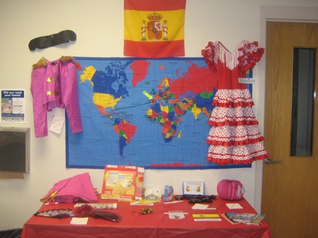
When I was in Sadler Elementary, the hallways were filled with student work of Spain. The teacher explained to me that monthly they due projects on different countries and post it on the hallway. Students learn about other countries this way and I would concur that this is a great idea! Students learn from different countries and feel more comfortable with other students from those countries.

Slide 7
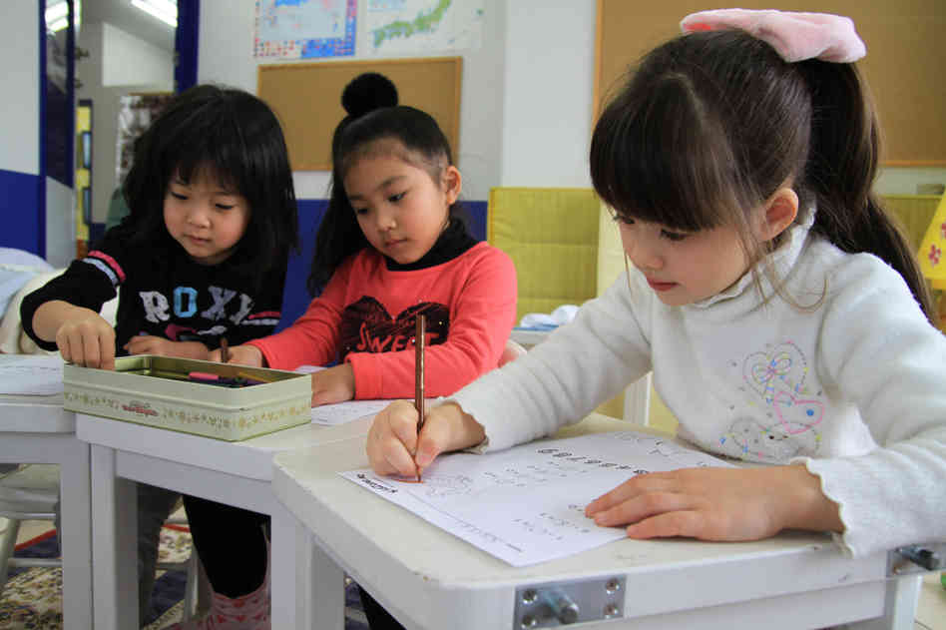
The assignment that Mr. Grace had the students do was a great way for them to learn objective and subjective culture. Students were to draw their face on a paper and write five things others would know about them. On the back they were to write five things others did not know about the individual. Students mostly posted on the front side what was easily visible perceived. On the back about what kind of music they listened to, beliefs, background, behavioral patterns and some customs.

Slide 8
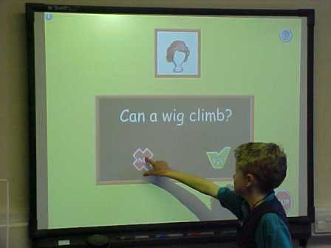
While I was observing a 4th grade math class reviewing fractions, the teacher used a touch screen projector. They would be doing fractions with pizza and students would go up to the board and add toppings. For instance, in a pizza divided in to eight pieces, the problem would give details of how the pizza is meant be: ¼ with cheese, ¼ with peperoni, ¼ with mushrooms and ¼ with pineapple. The students would go up to the board, pick the ingredient and put the ingredients on the pizza.

Slide 9
Teacher Interview
Exceptional Education Field Observation
Teacher Interview
Name of teacher: Elizabeth Velez School: Sadler Elementary Grade: 1-5th
1.What exceptionality do the students have? What grade level and what age are they?
The students each have their own needs and learning disability. For instance, one students is mildly hyper, other one still wears diapers for he might pee himself, and another girl has a condition where she talks to herself, and sometimes loud. Currently she has students from 2nd to 5th grade. Ages range from 6 to 9.
2.What needs do the children seem to have that are unique to this group? Common to other children? What modifications in instructional approach are made?
Some students forget the lesson quickly. After lunch, they would forget the lesson the teacher taught earlier in the day; therefore, she knows she probably would have to refresh the lesson again after lunch. This is somewhat common in her class.
3.What recommendations does the parent have for you regarding what you might provide for children who have special needs?
There are parents who like to help and there are those who do not have interest in their child; unfortunately, even more sometimes because their child has a special need. Some parents do provide tips and give as to how to handle their child and their needs. Others recommend ideas about environment background or teaching ideas. Some parents volunteer and occasionally help. It is a lot of work!
4. How have you been affected by the education policy directed at children with special needs? What modifications has the teacher made in teaching? What do you do as a teacher still feel is needed?
The teacher has students from different grades and with different needs. What she would do is focus on the students who need more help and attention; meanwhile, she would have her assistant work with the other students who are more capable of working independent. The teacher feels sometimes another assistant is needed. There are times where all the students at once get loud or misbehave and sometimes it can be a bit difficult to handle them all at once. More parent support is needed, what is she to do for the student when the parents do not have interest in their child’s education? She has several Haitian and some Hispanic students (especially those whom just arrived to the Florida) and their parents do not seem too concerned about their education.
5. What types of assistive technology do you to accommodate the special needs of your students?
She plays kid’s songs and melodies in the background while the students do their classwork or while the teacher assist other students. She also uses an interactive projector/whiteboard where she would put videos from youtube that teaches about the months, seasons, day of the week, recognizing money, etc. Some of the videos are both sing along and dance along but most are sing along. She has this exercise everyday usually before it is time for the students to leave.

Slide 10
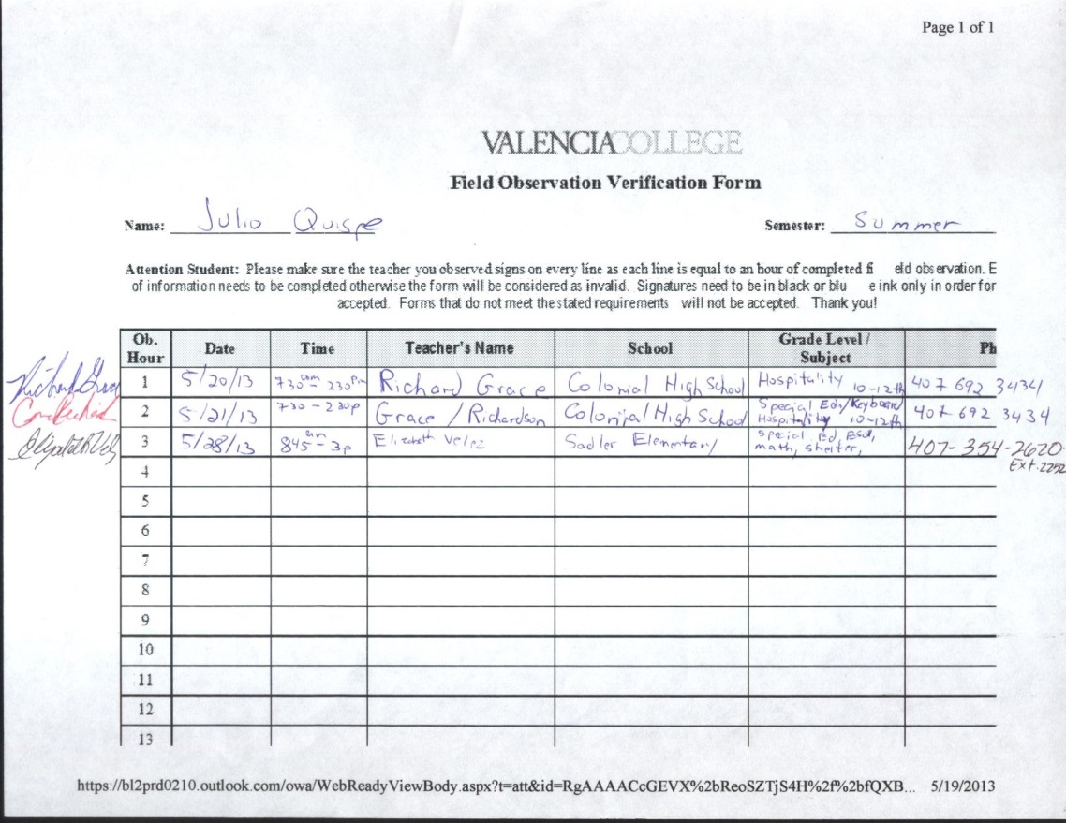
Verification Form

